Slide 1
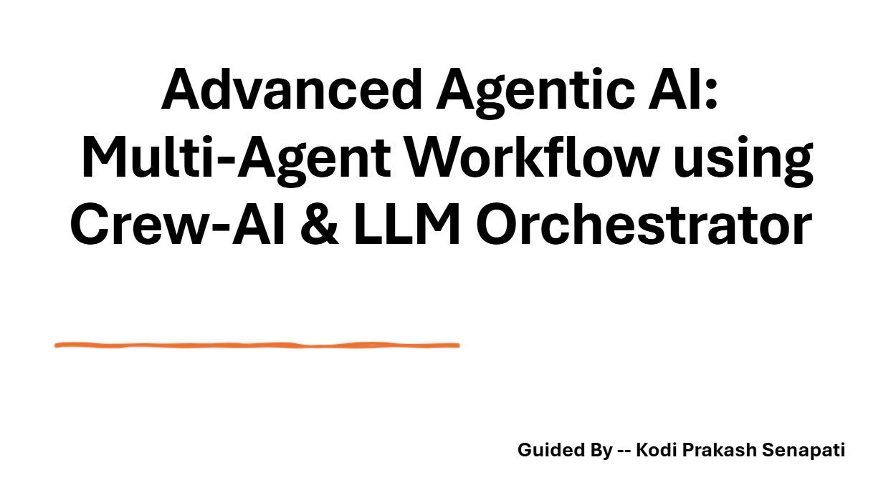

Slide 2
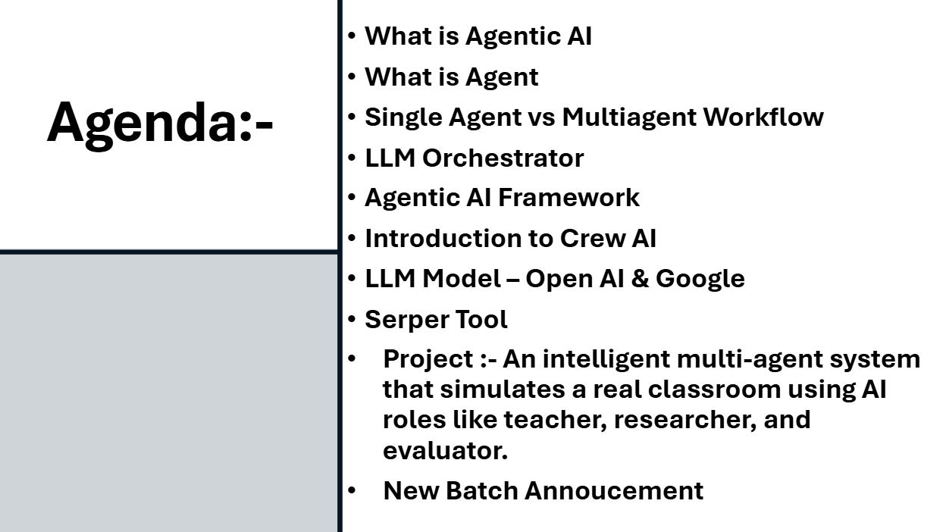

Slide 3
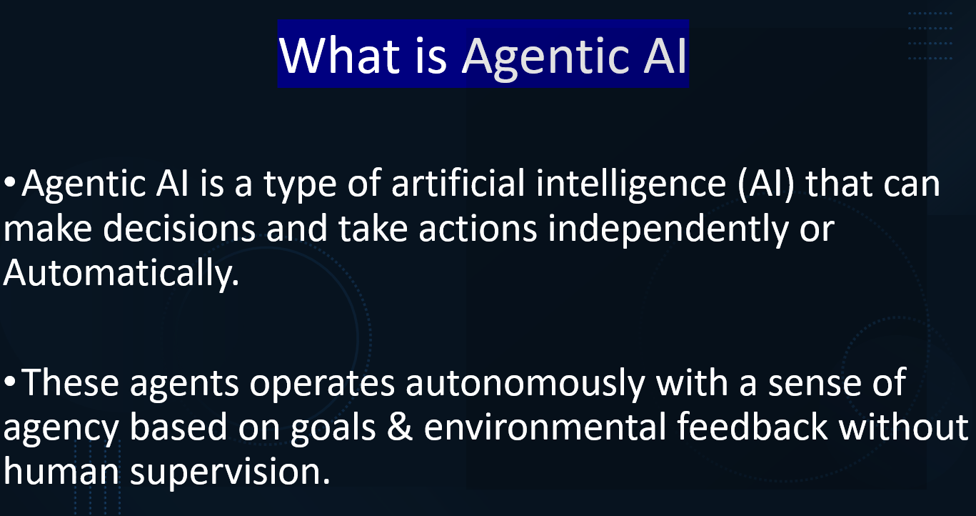

Slide 4


Live Webinar Link➔
https://zoom.us/j/87240377311

Slide 5
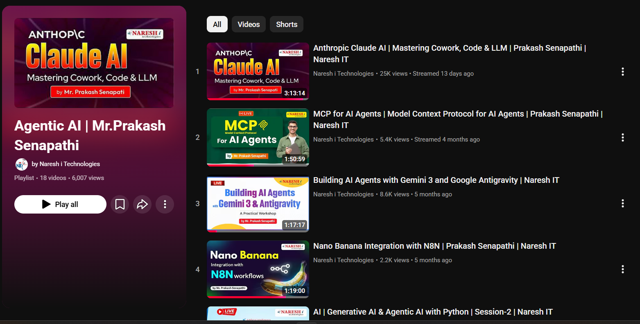
Advanced Agentic AI Playlist
https://www.youtube.com/playlist?list=PLVlQHNRLflP8Pt3wVlRWRaXZXi79cIwSq

Slide 6
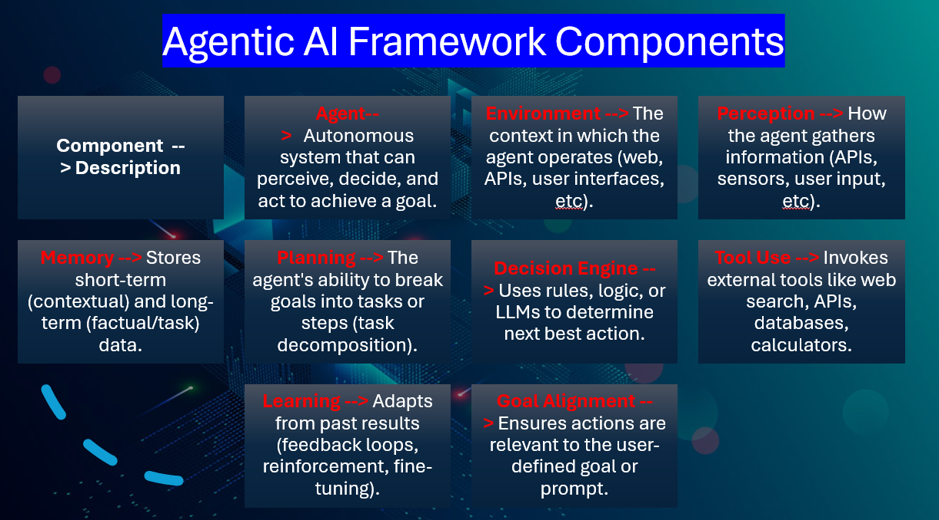

Slide 7
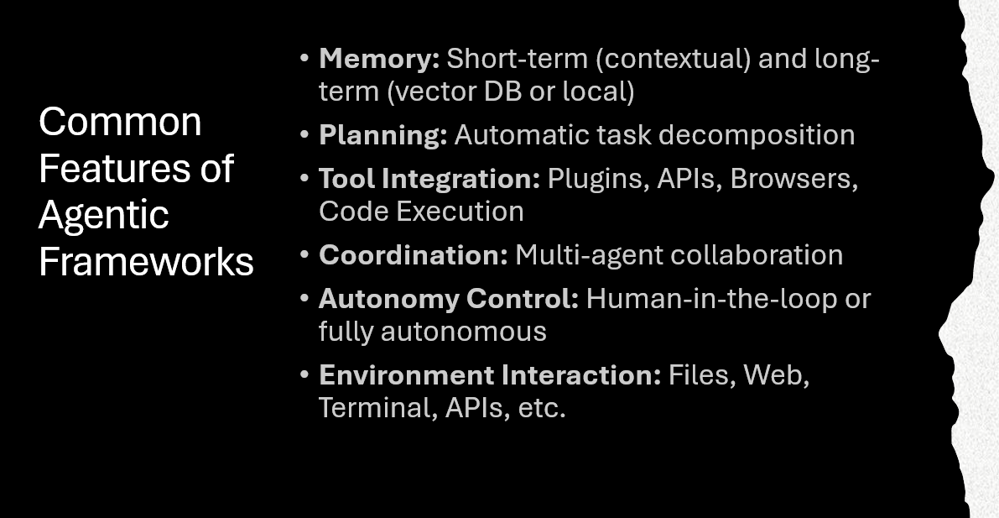

Slide 8


Refer to the documents →
https://docs.crewai.com/
Crew ai GitHub →
https://github.com/crewAIInc/crewAI

Slide 9
PROJECT: CREW AI MULTIAGENT WORKFLOW
Software application – GOOGLE COLAB
Reference – GITHUB CREW AI
LLM MODEL – OPEN AI API KEY (PAID ONE) → PLATFORM.OPENAI.COM | GEMINI API
SERPER API KEY → https://serper.dev/
WHAT IS SERPER ?
SERPER IS AN API THAT ALLOWS DEVELOPERS TO RETRIEVE GOOGLE SEARCH RESULTS IN A STRUCTURED FORMAT. IT CAN BE USED TO PULL SEARCH DATA, SUCH AS WEB PAGES, NEWS ARTICLES, AND SUMMARIES, AND INTEGRATE THEM INTO OTHER APPLICATIONS. THIS IS PARTICULARLY USEFUL FOR BUILDING SEARCH FUNCTIONALITIES WITHIN APPS WITHOUT RELYING DIRECTLY ON GOOGLE'S TRADITIONAL INTERFACE.
FOR EXAMPLE, DEVELOPERS CAN USE THE SERPER API TO AUTOMATICALLY FETCH AND SUMMARIZE NEWS ARTICLES RELATED TO SPECIFIC SEARCH QUERIES, MAKING IT EASIER TO GENERATE QUICK INSIGHTS FROM GOOGLE SEARCH RESULTS. THE API IS COMMONLY USED IN CONJUNCTION WITH TOOLS LIKE LANGCHAIN, WHERE IT HELPS STREAMLINE WORKFLOWS BY COMBINING SEARCH AND AI-GENERATED SUMMARIES, SUCH AS SUMMARIZING SEARCH RESULTS USING MODELS LIKE GPT
THIS TOOL CAN BE HELPFUL FOR BUILDING APPS THAT NEED TO DISPLAY SEARCH CONTENT OR ANALYZE SEARCH RESULTS PROGRAMMATICALLY, MAKING IT A FLEXIBLE RESOURCE FOR DEVELOPERS.

